Slide 1
CTIT RT Fault Detection

Slide 2

Agenda
Different methods for Fault Detection
Market study
Proposed Method

Slide 3
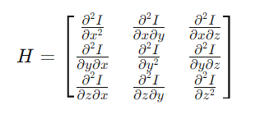
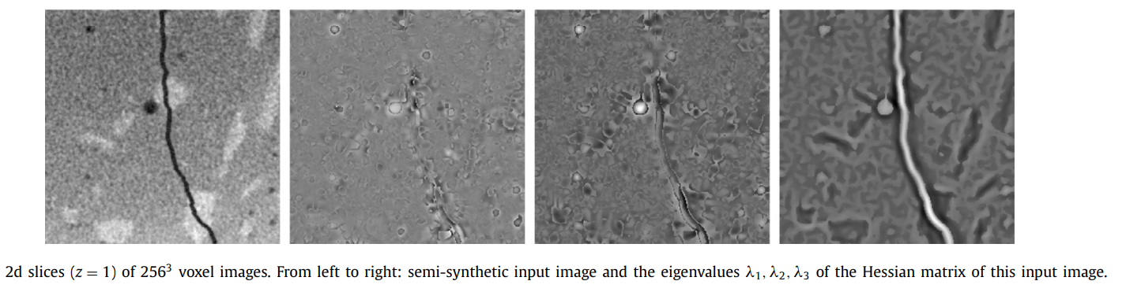
Paper Review:
Different methods of Fault detection
1.Hessian Matrix
The Hessian matrix H of a scalar-valued function I(x,y,z) in a 3D voxel-based image is defined as:

Slide 4
2.Sheet Filter(SF)
The sheet filter detects flat structure in an image based on a suitable composition of Hessian eigen value.
The higher S(p), the more likely the voxel p belongs to a crack structure.
3. Frangi Filter(FF)
It was originally developed to detect tube-like structure in medical images and can be adjusted to also detect plate like structure.
Similar to sheet filter
The higher F(p), the more likely the voxel p belongs to a crack structure .

Slide 5
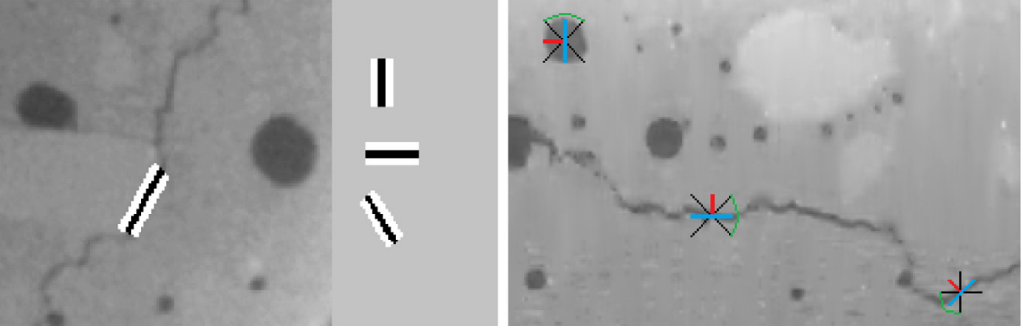
4. Template Matching(TM)
(a) Template matching
(b) Adaptive Plane Morphology
5.Adaptive Plane Morphology(AM)
Involves morphological operation (e.g. dilation, erosion) that adapt to local image characteristics such as intensity gradient.
Suitable for segmenting region with non-planar or irregular structure.

Slide 6
6. Minimal Paths(MP)
The procedure is based on modelling the image as a 3D vertex-weighted, directed graphs. The voxels are the nodes weighted by their gray values.
Starting from a voxel p, minimal paths are computed using a percolation algorithm.
7. Percolation and Hessian Percolation Method(PM)
Percolation refers to the movement or filtering of fluids through porous materials. In algorithm terms, percolation algorithms analyze how clusters or connected components energy and evolve in a system under certain condition.
Designed for detecting crack in 3D images, focusing on identifying connected sets of voxels that exhibit characteristics indicative of cracks.
Notes:
1. For production spreate process

Slide 7
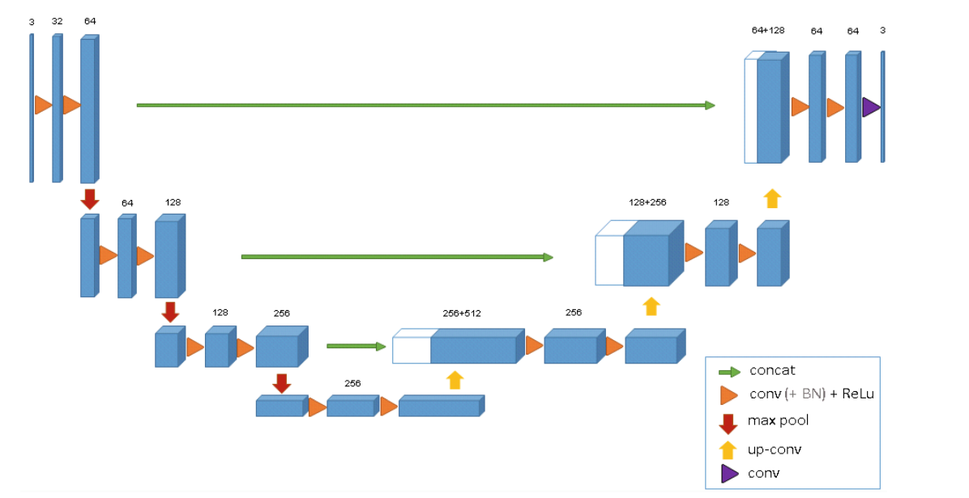
Supervised Learning Methods
1. Random Forest
The Random Forest model can segment an entire image by predicting whether each voxel belongs to a crack or not, based on its learned features and the decision of multiple trees.
Features for training each tree include: Gray values of voxels from the original image, Transformed version of the image, which include filters, gradients, statistical measure etc.
2.Deep learning: 3D U-net(NN)
Designed originally for biomedical image segmentation including structure like crack in 3D voxel-based image from CT scan.

Slide 8
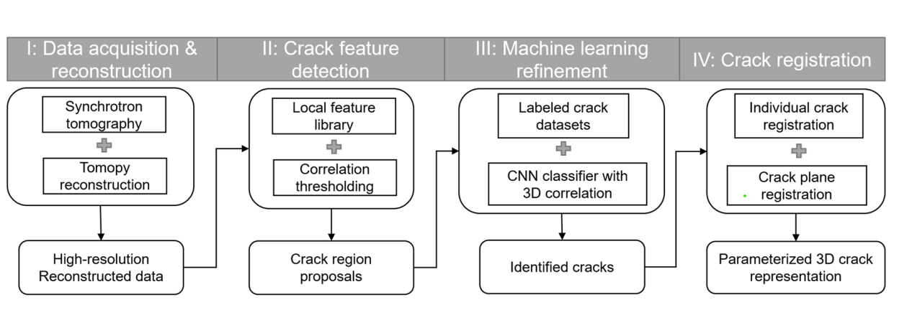
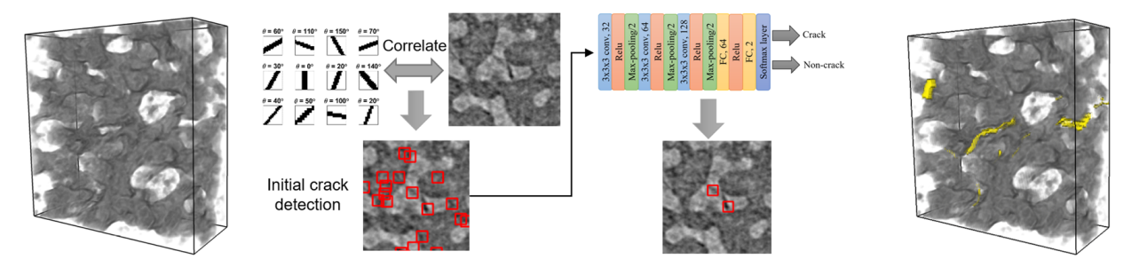
3. 4-Step pipeline for automatic crack detection

Slide 9

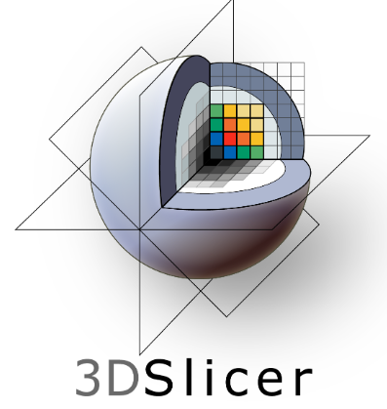
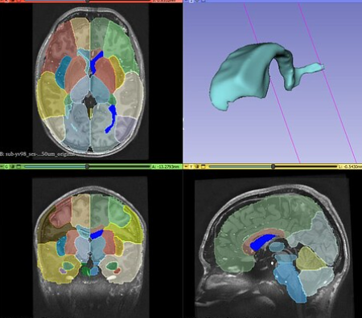
Software available for crack segmentation
1. Dragonfly
2. 3D Slicer
Links: https://youtu.be/648R-rjHr2Q?si=1zaQr2QUulu7Fjtc

Slide 10
Proposed Method
1. Method 1:
Same diameter and length pipe which doesn’t have any fault
Matching with fault pipe with maximum correlation
Subtracting faulty and non-faulty pipe
Applying deep learning methods to get better accuracy
Requires less amount of data
Faster
Good accuracy
2. Method 2: Similar to 4-Step pipeline on crack detection

